Slide 1

Team Details
Team Name: Eror4o4
Team Leader Name: Akshath Rajkumar
Problem Statement: Controlled Fertilizing in Agriculture Using YOLO Model (Track 1- Smart agriculture on a budget)

Slide 2
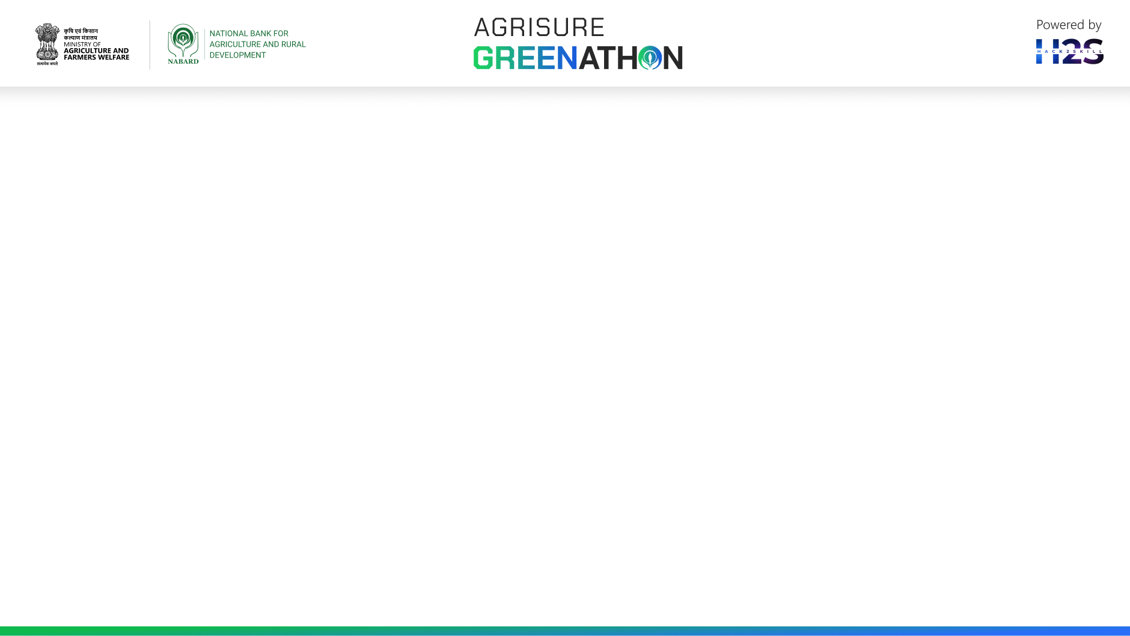
Brief about the idea
Efficient fertilizer use is crucial in modern agriculture for maximizing crop yields, reducing costs, and minimizing environmental impact.
Traditional fertilizing methods often result in uneven distribution, leading to over-fertilization or under-fertilization, increased costs, soil degradation, and environmental pollution.
Objective
Develop an cheap and automated fertilizing system using Artificial Intelligence and Machine Learning.
Detect precise seedling locations with a YOLO (You Only Look Once) model.
Apply fertilizer only where needed to optimize usage, reduce waste, and promote sustainable farming practices.

Slide 3
Opportunities
How different is it from any of the other existing ideas?
Most modern farming techniques like drip fertilization (fertigation) require significant initial investment for irrigation infrastructure. Drones used for fertilization are also expensive to maintain and have low accuracy. Our model eliminates these expenses, by using camera sensors and reduces fertilizer costs and improves environmental conditions in the long run.
How will it be able to solve the problem?
In Indian agriculture, farmers typically focus on applying a specific amount of fertilizer per acre of land. Our model, however, targets fertilization at the level of each individual plant or crop. This approach significantly reduces the amount of fertilizer used by about 56%, as stated in an BBC interview, thereby lowering costs and improving soil quality.

Slide 4
List of features offered by the solution
Precision Detection: Utilizes a YOLO model to accurately detect and locate individual seeds or plants within the field.
Targeted Fertilization: Applies fertilizer directly to the detected locations, ensuring precise nutrient delivery.
Cost Efficiency: Reduces fertilizer usage by approximately 56%, leading to significant cost savings. Eliminates the need for expensive irrigation infrastructure required by methods like drip fertilization.
Environmental Sustainability: Minimizes fertilizer runoff, reducing environmental impact and improving soil health.
Scalability: Suitable for small, medium, and large-scale farms due to its flexibility and low-cost implementation.

Slide 5
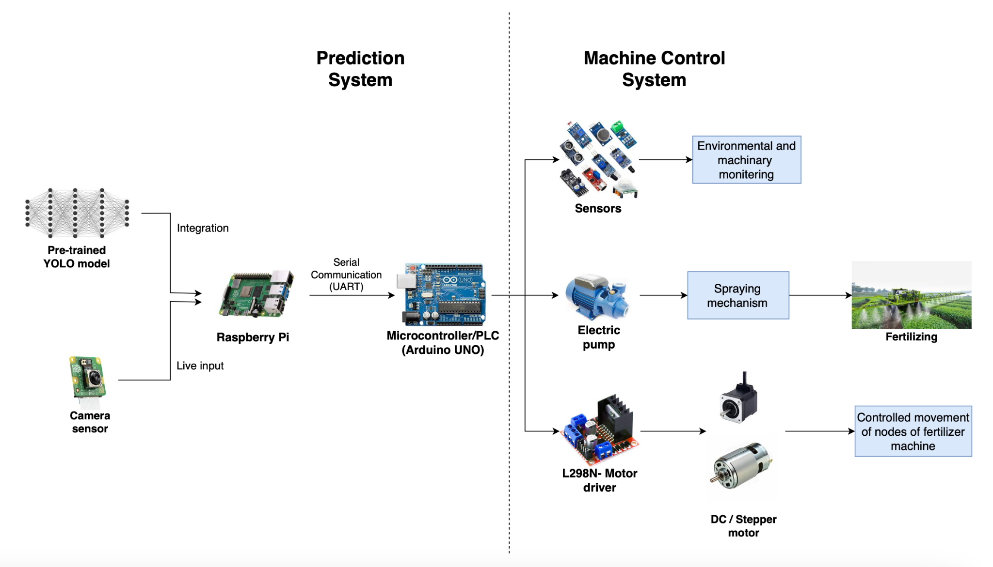
Process flow diagram or Use-case diagram

Slide 6
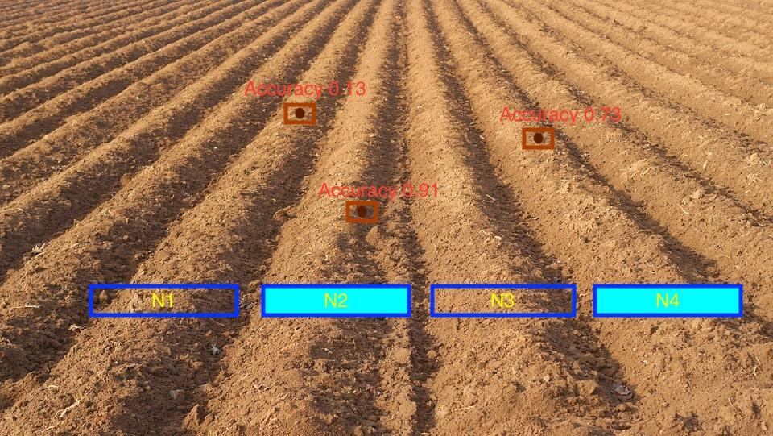
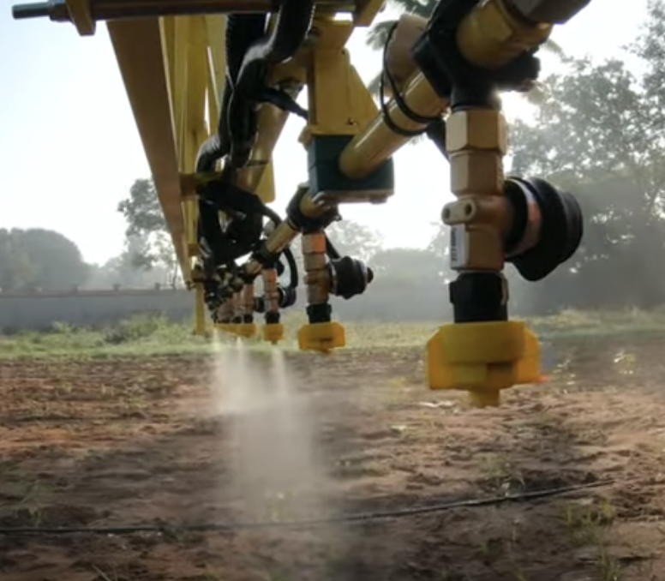
Wireframes/Mock diagrams of the proposed solution
The blue boxes represent the range of spraying for each node of the fertilizer machine. When a seedling is detected with high accuracy, only that particular node gets activated for spraying.
YOLO model detection
Nodes in fertilizing machine

Slide 7
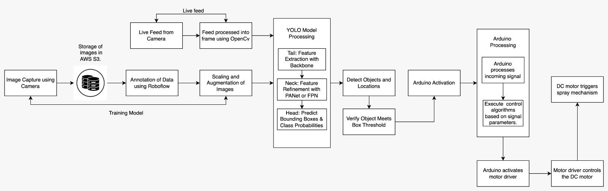
Architecture diagram of the proposed solution

Slide 8





Technologies to be used in the solution

Slide 9
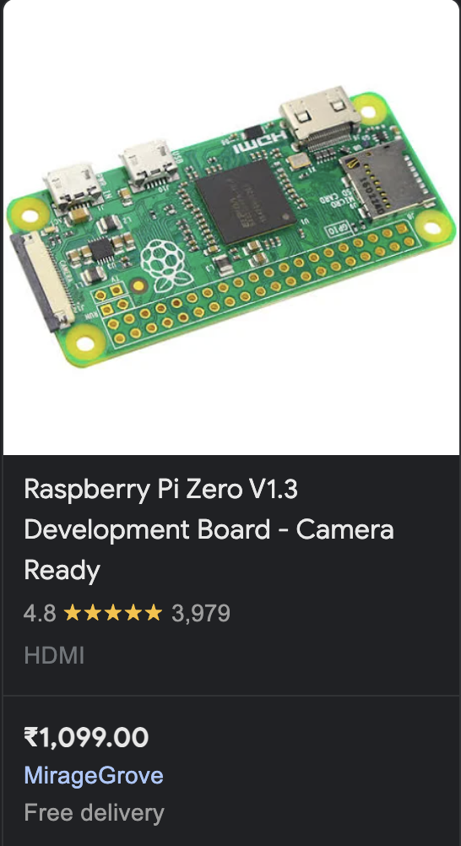
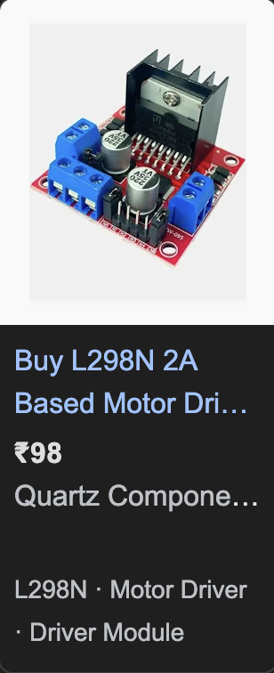
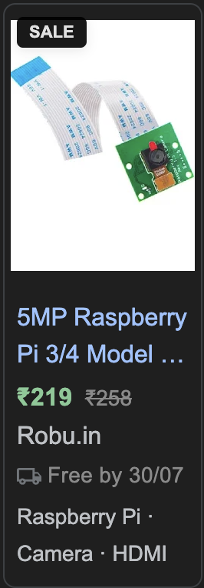
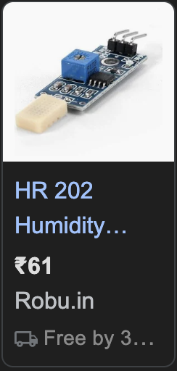
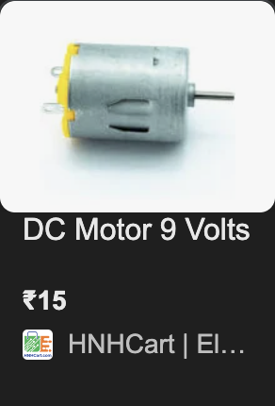
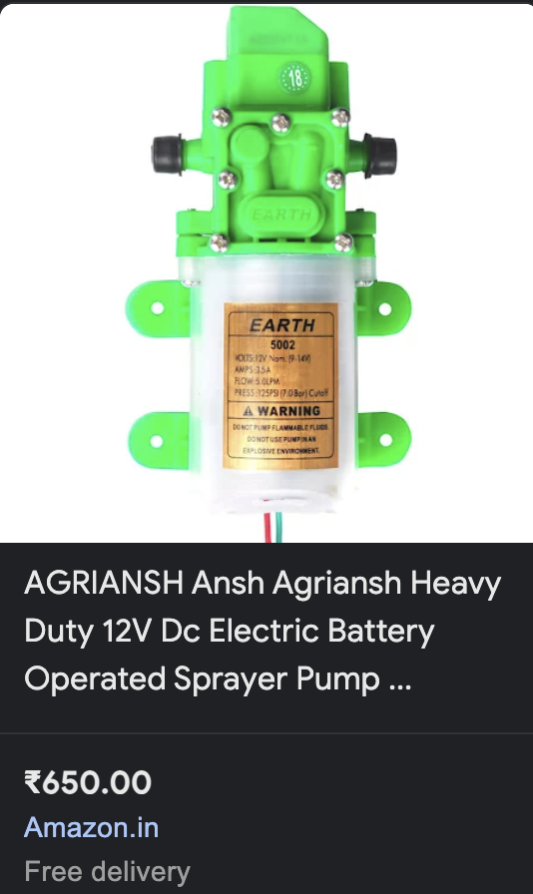
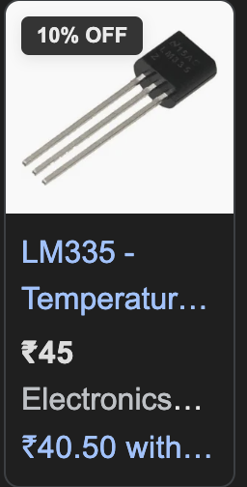
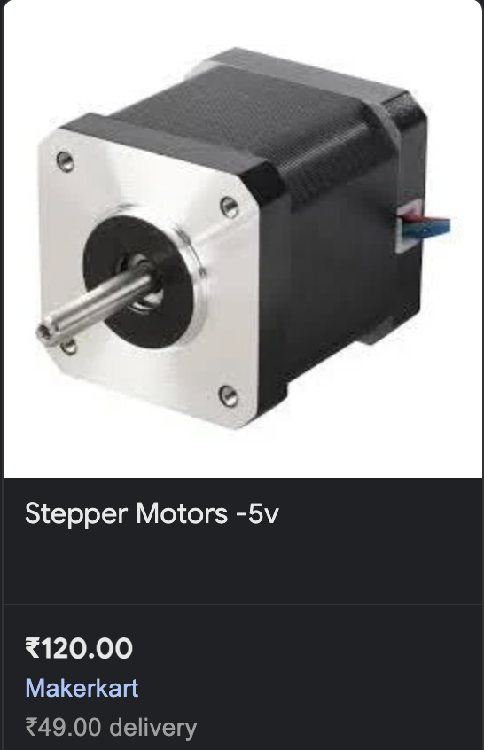
Estimated implementation cost
Hardware Component Cost - Rs.2307
Miscellaneous Costs - Rs.1000 to Rs.1300
Total Cost- Rs. 3,500 approx.

Slide 10
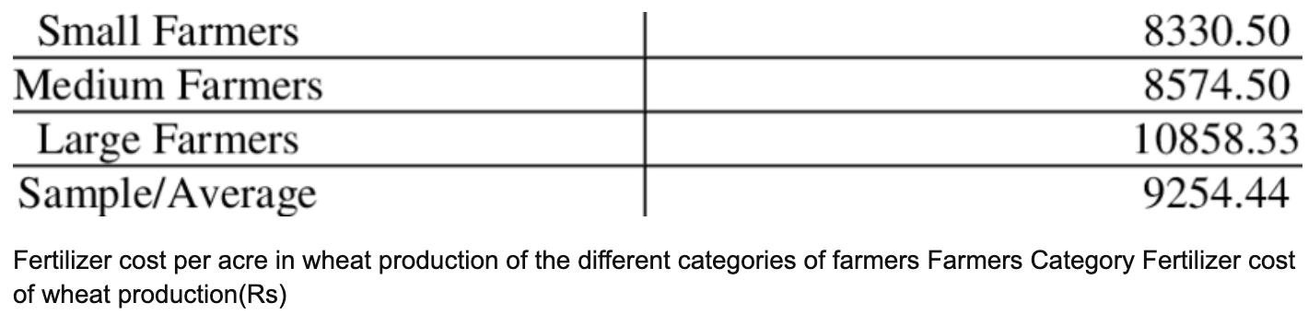
The cost mentioned is a one-time investment.
For small-scale farmers, the fertilizing machine can have 1 or 2 nodes.
For medium and large-scale farmers, the machine can have 15 to 20 nodes.
Each additional node increases the production cost by approximately Rs.1000.
This method reduces fertilization costs by 56%, as stated in an interview in BCC, saving around Rs.5128 per acre every time it is fertilized.
Fertilizer is applied about 4 times a year, potentially saving over Rs.20,500 per acre every year.
Citation- Memon, Noor & Noonari, Sanaullah & Laghari, Majid & Pathan, Maria & Khajjak, Akbar & Memon, Zarmina & Khan, Danyal & Pathan, Amber & Sial, Sajid. (2015). Energy Consumption Pattern in Wheat Production in Sindh Pakistan.

Slide 11
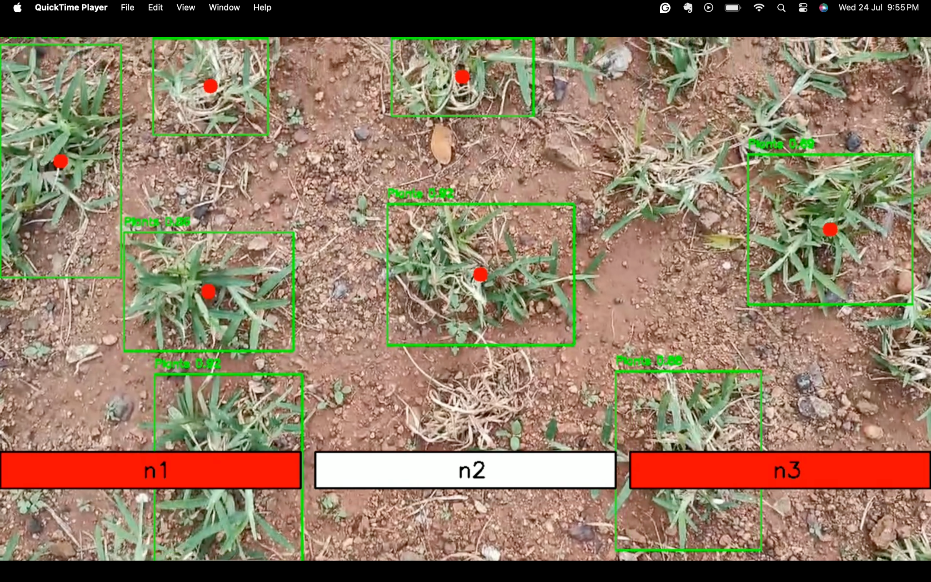
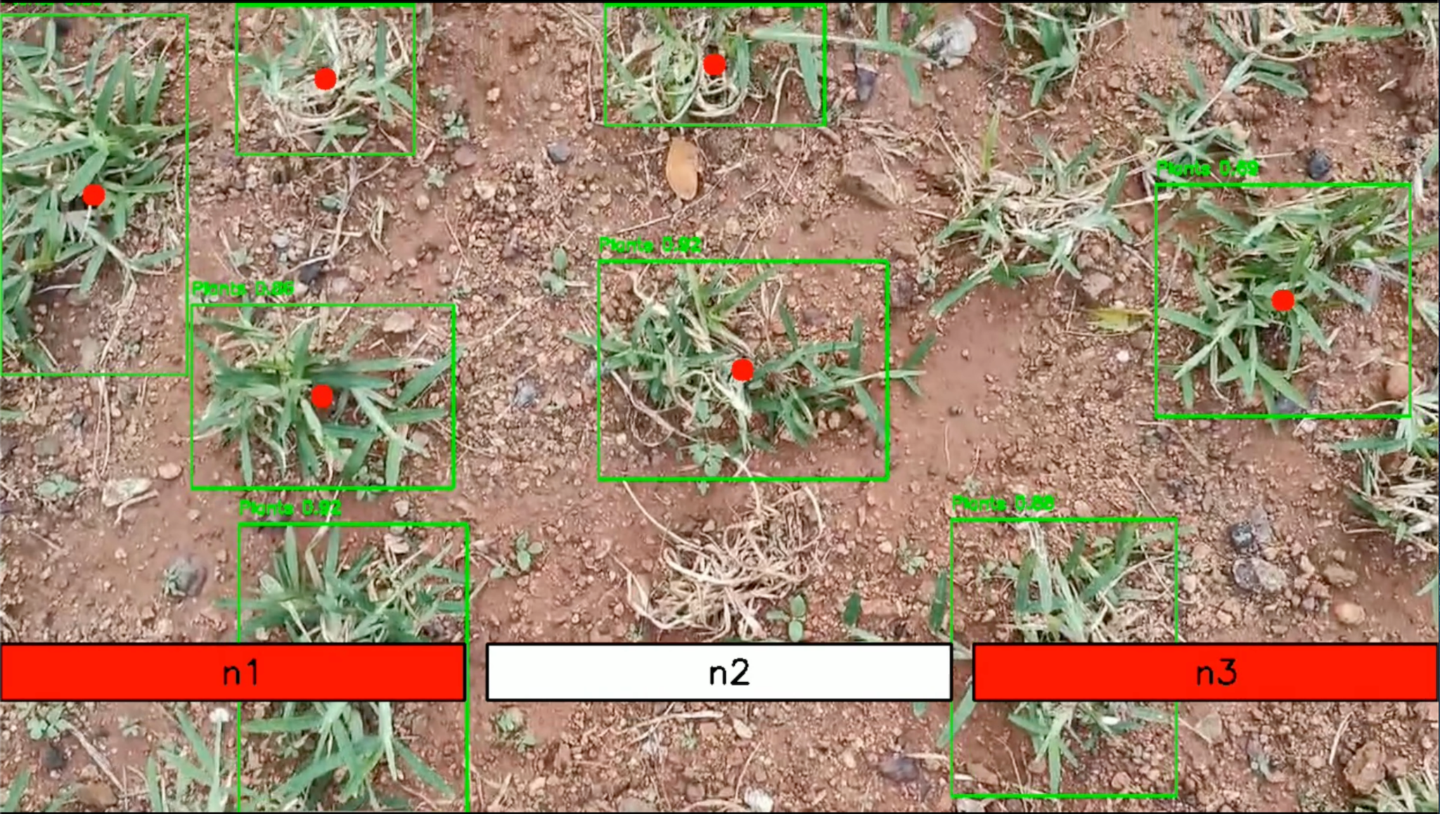
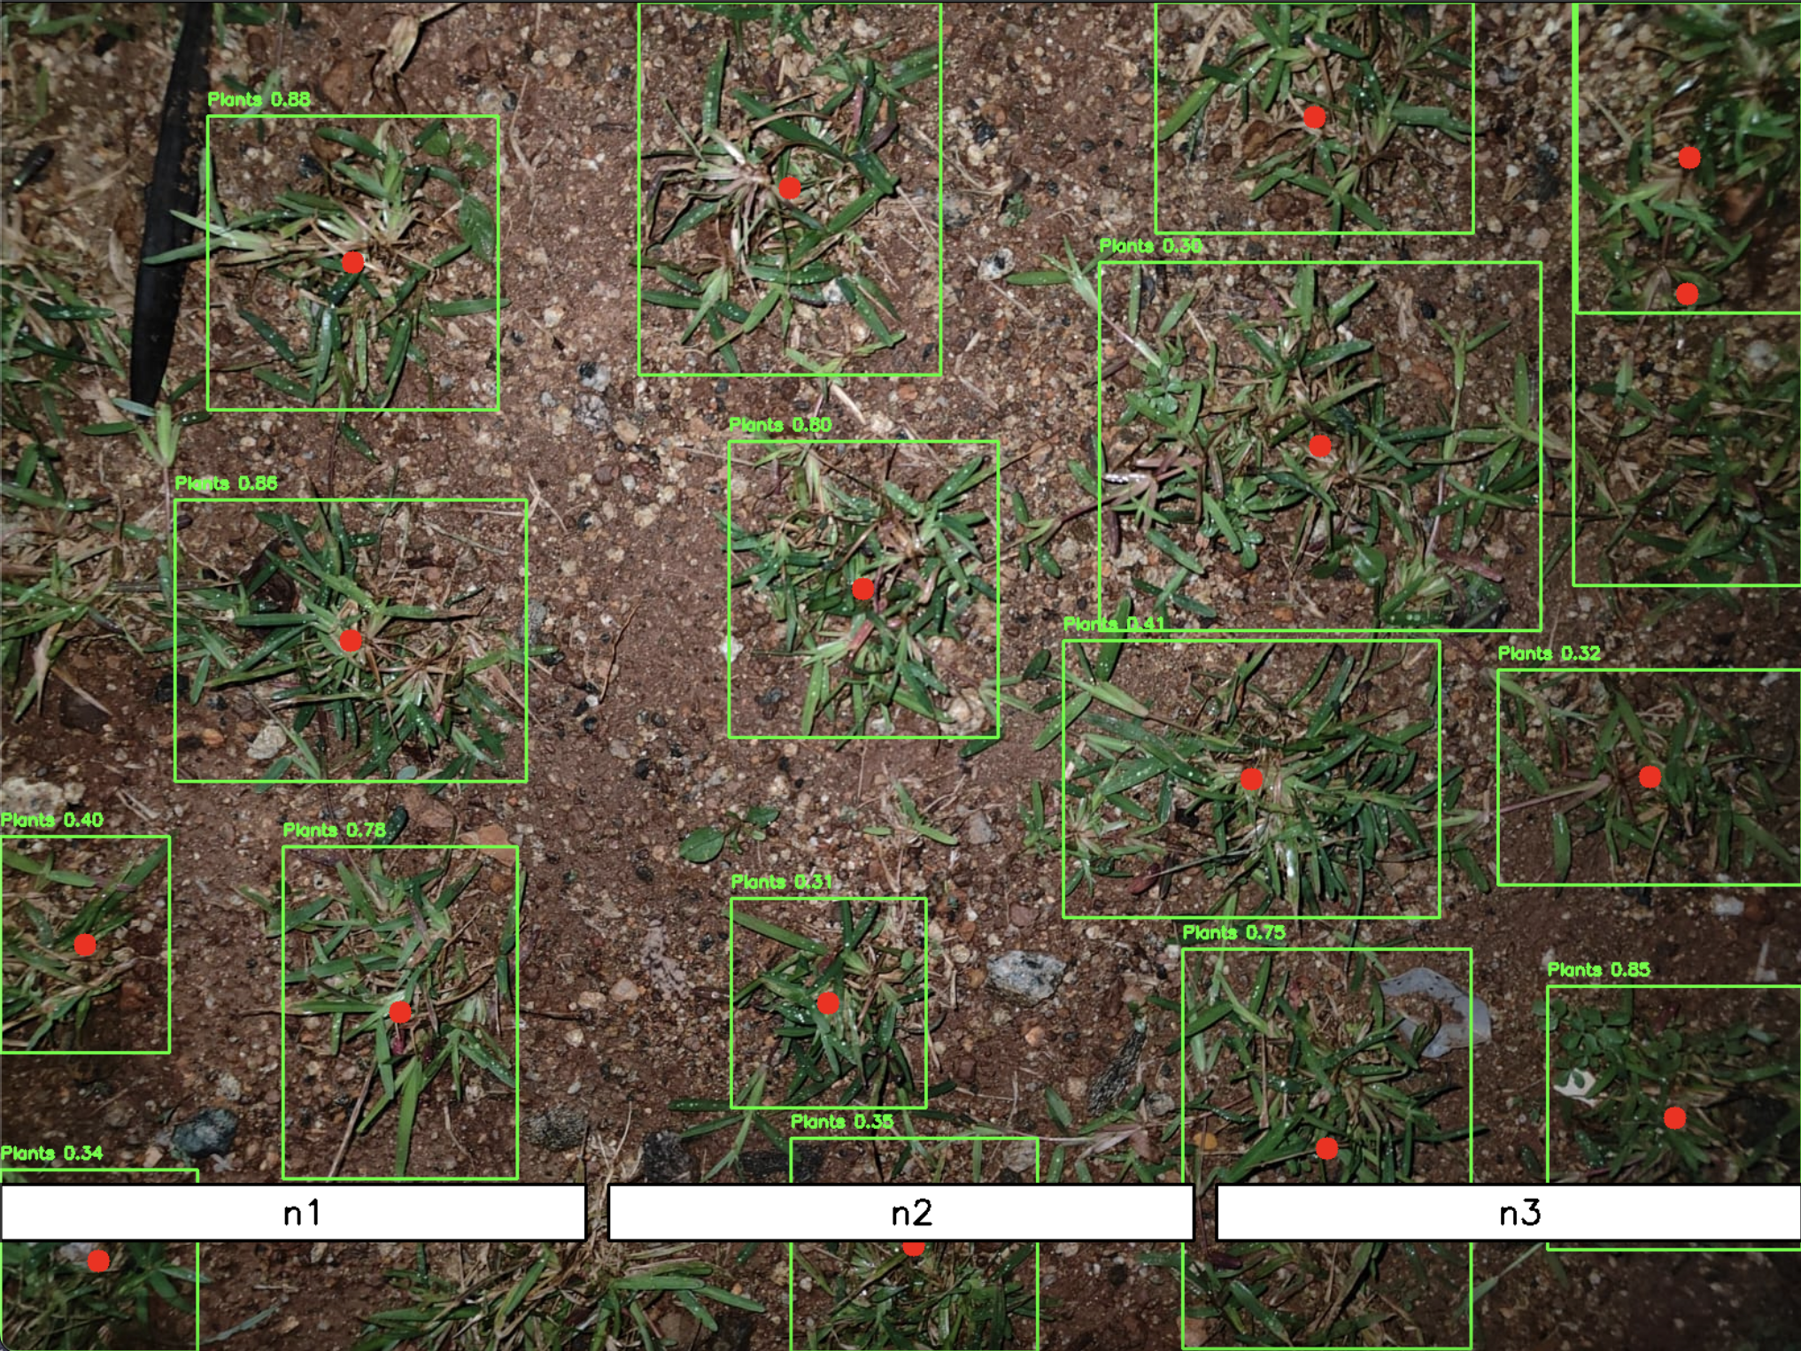
Snapshots of the prototype
AI model successfully detecting plants in both night and day time
Day time
Night time

Slide 12
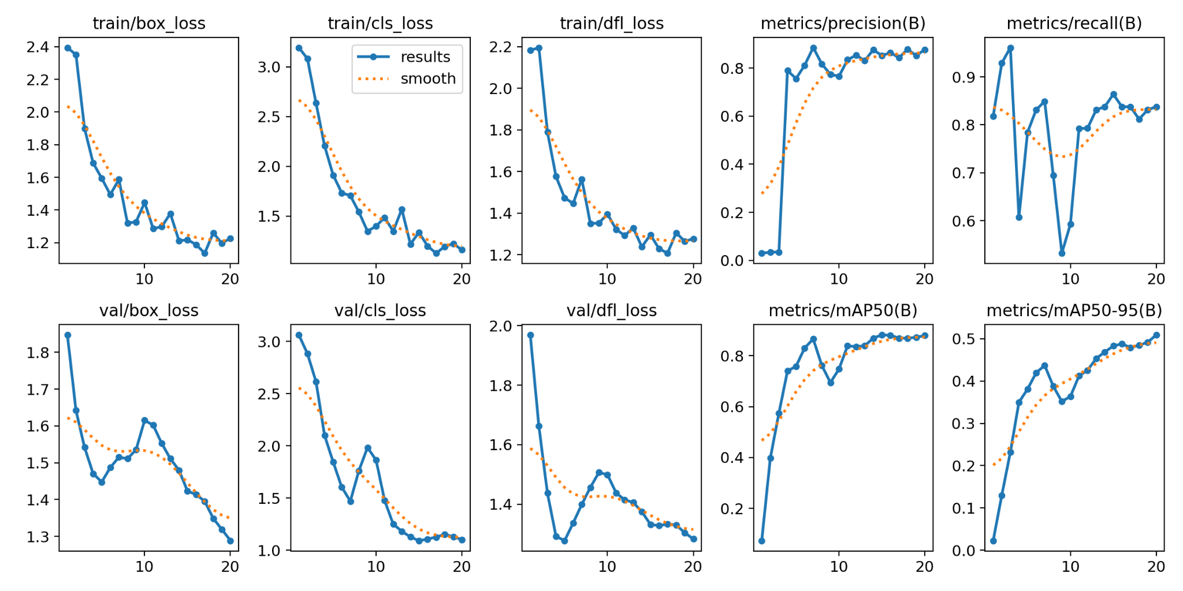
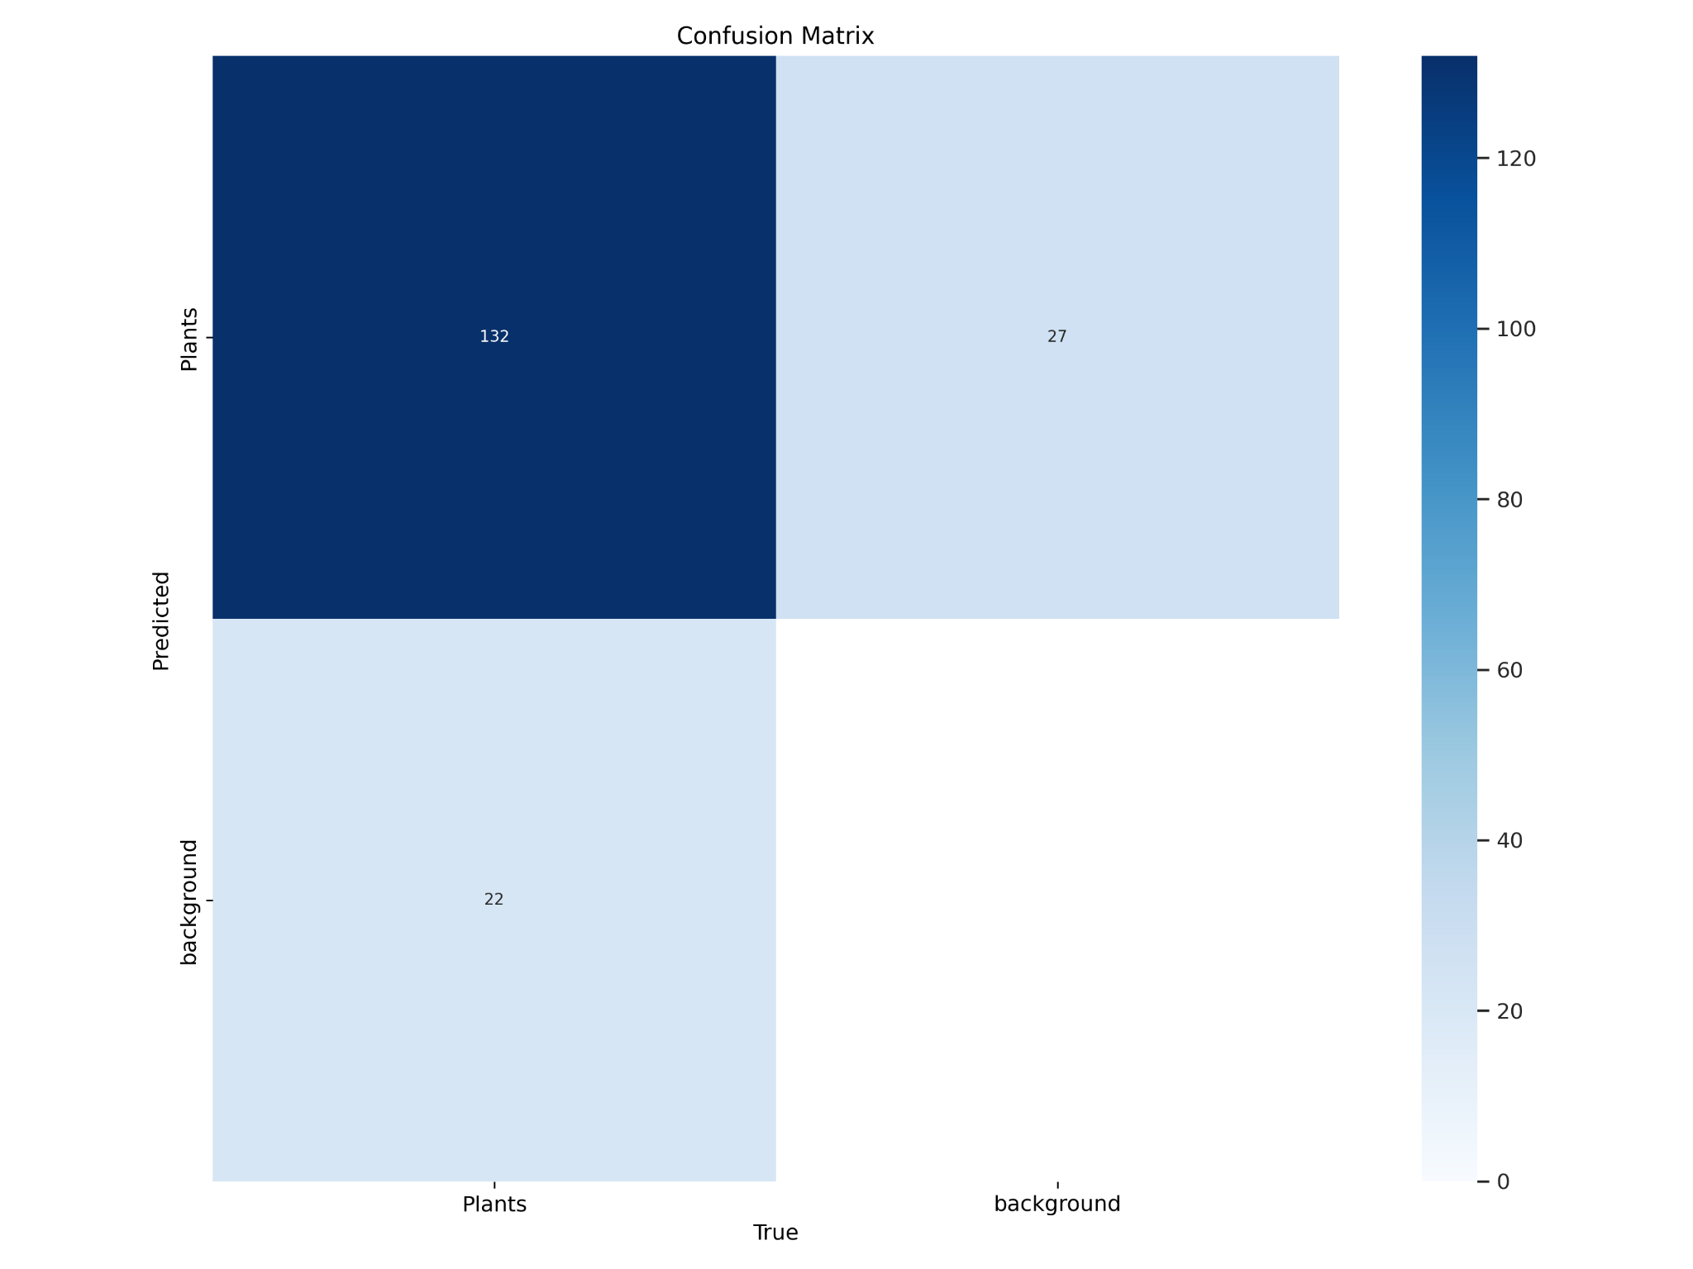
Prototype Performance report/benchmarking
All metrics graph
Confusion Matrix

Slide 13
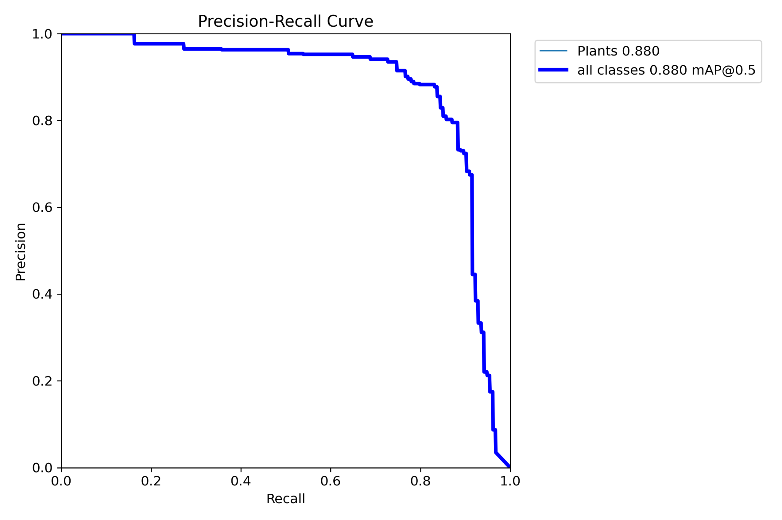
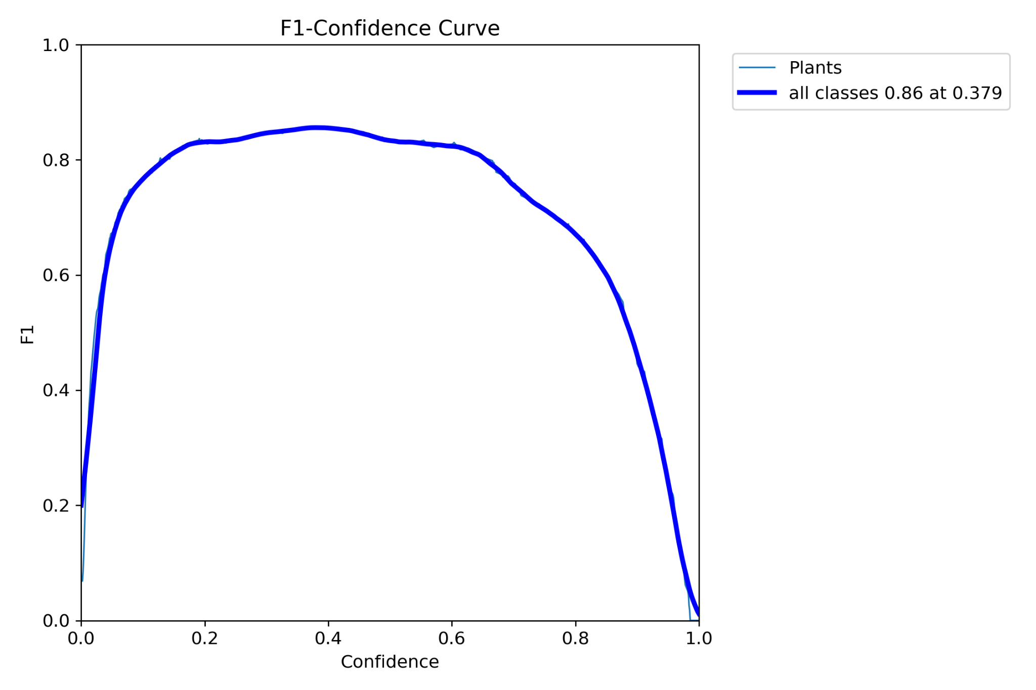
PR Curve
F1 Curve
The data to train model was manually collected from a local park due to the absence of nearby farms and dataset on internet. Considering the model has been trained only for 70 images and 20 epochs, it has shown promising results. It has over 0.88 mAP (mean average precision) and 0.86 F1 curve value in validation set, which is impressive for a small training dataset.

Slide 14
Additional Details/Future Developments
Few of the possible future developments includes:
Advanced User Interfaces: Developing intuitive and user-friendly interfaces for controlling and configuring motor systems.
Edge Computing: Implementing edge computing for real-time data processing and decision-making in motor control systems.
Multi-Crop Detection: Adapt the system to identify and differentiate between various types of crops or plants.
Data Analytics: Incorporate data analytics to provide insights into crop health, fertilizer efficiency, and overall field performance.
Autonomous Operation: Advance towards full autonomy with navigation and operation without human intervention, incorporating features like obstacle detection and path planning.

Slide 15
GitHub Public Repository Link & Demo Video Link
Github Link:
https://github.com/akshath-raj/Eror4o4_PrecisionFertilization
Demo video Link:
NOTE:
Sadly, the hardware components we ordered has been delayed and we could not set up the hardware within submission time. Hence we will only show the AI model and its performance in the demo.
If you have gone through the PPT please feel free skipping to timestamp 1:31.
https://drive.google.com/file/d/1ud45KipSP04moLdWc4C4qH4Bd2d_Dgyq/view?usp=sharing

Slide 16


